Slide 1
Systems of Systems- Engineering and Mathematics
Laura Antul
Judith Dahmann

Slide 2
Topics
What is Systems Engineering?
What is Systems of Systems (SoS) Engineering?
How can mathematics contribute to Systems of Systems Engineering?

Slide 3
Systems Engineering

Slide 4
What is SE?
Definition of Systems and SE
“A system is a construct or collection of different elements that together produce results not obtainable by the elements alone.” [1]
“Systems Engineering is an engineering discipline whose responsibility is creating and executing an interdisciplinary process to ensure that the customer and stakeholder's needs are satisfied in a high quality, trustworthy, cost efficient and schedule compliant manner throughout a system's entire life cycle.” [1]
[1]"What is Systems Engineering", Incose.org, 2017. [Online]. Available: http://www.incose.org/AboutSE/WhatIsSE. [Accessed: 15- Jul- 2017].

Slide 5
MIT: Systems Introduction
Characteristics [2]
Interaction
Hierarchical
Emergent
Dynamic
Interdisciplinary
Application Domain Examples [2]
Aerospace
Communication systems
Information systems
[2]Q. Hommes, P. Hale and D. Erickson, "ESD.33 Systems Engineering Lecture 1 Course Introduction", MIT, 2010.

Slide 6
MIT: Systems Introduction (cont.)
Process Models [2]
Waterfall
Spiral
INCOSE VEE
[2]Q. Hommes, P. Hale and D. Erickson, "ESD.33 Systems Engineering Lecture 1 Course Introduction", MIT, 2010.

Slide 7
SEBoK: Systems Engineering Overview
Project Lifecycle [3]
SE Scope [3]
[3]"Systems Engineering Overview - SEBoK", Sebokwiki.org, 2017. [Online]. Available: http://sebokwiki.org/wiki/Systems_Engineering_Overview. [Accessed: 15- Jul- 2017].
Notes:
Project Lifecycle - The lifecycle is an iterative process that begins with the owners and users of the systems negotiating system objectives and constraints then moves to developing the system definition and developing the system initial operational capability which is then analyzed and brought to users and owners for feedback and then finally the next system increment is developed, analyzed, and modified which produces the evolved system.
Scope – “The scope of SE does not everything involved in the engineer and management of an engineered system. Activities can be part of the SE environment, but other than the specific management of the SE function, not considered to be part of SE. Examples include system construction, manufacturing, funding, and general management. This is reflected in the International Council on Systems Engineering (INCOSE) top-level definition of systems engineering as, “an interdisciplinary approach and means to enable the realization of successful systems.” (INCOSE 2012) Although SE can enable the realization of a successful system, if an activity that is outside the scope of SE, such as manufacturing, is poorly managed and executed, SE cannot ensure a successful realization.”

Slide 8
System of Systems Engineering (SoSE)

Slide 9
Overview of SoS
Definition of SoS and SoSE
“System of Systems is a “set or arrangement of systems that results when independent and useful systems are integrated into a larger system that delivers unique capabilities””. [4]
“Systems of Systems Engineering is “the process of planning, analyzing, organizing, and integrating the capabilities of a mix of existing and new systems into a system-of-systems capability that is greater than the sum of the capabilities of the constituent parts”. [4]
[4]Department of Defense, "US Defense Acquisition Guidebook", Defense Acquisition University, 2008.
Notes:
Definitions – “System of Systems is a “set or arrangement of systems that results when independent and useful systems are integrated into a larger system that delivers unique capabilities”. Systems of Systems Engineering is “the process of planning, analyzing, organizing, and integrating the capabilities of a mix of existing and new systems into a system-of-systems capability that is greater than the sum of the capabilities of the constituent parts.””
Characteristics – Operational independence of constituent systems, Managerial independence of constituent systems, Geographical distribution, Evolutionary development, Emergent behavior
Scope – Technical (“example from an European Commission (EC) research project COMPASS6 which used as a case study in SoS the integration of the components of a consumer audio-visual ‘system’”), Socio-Technical (“example of a disaster response SoS, In disaster response, the coordinated activities of the various responder organizations are as important to the success of the SoS as is the integration of the supporting technical systems”), Enterprise (“SoS can be broader in their scale and scope and address enterprise level concerns. In the figure this is shown by work on fighting the problem of counterfeiting as an enterprise comprised of a wide variety of systems, organizations, policies, and competing efforts”). Domains – “Missions: Sets of systems working together to provide a broader capability to support a military mission”, “Platforms: A military platform (e.g. ship, aircraft, satellite, ground vehicle) equipped with independent systems (i.e. sensors, weapons, communications) need to meet platform systems objectives”, “Information Technology (IT): Networked information systems within or across platforms or systems to meet mission or capability objectives”.
Types – Directed, Acknowledged, Collaborative, Virtual.
Aspects – Covers how SoS differ from systems in regards to “Physical vs Socio-Technical Considerations”, “Alignment with funding and management”.
Challenges – Such as SoS Authorities, Leadership, Constituent Systems’ Perspectives, Capabilities and Requirements, Autonomy, Interdependencies and Emergence, Testing, Validation, and Learning, and SoS Principles.

Slide 10
MITRE: Overview of SoS (cont.)
Characteristics [5]
Operational independence of constituent systems
Managerial independence of constituent systems
Geographical distribution
Evolutionary development
Emergent behavior
Type [6]
Directed
Acknowledged
Collaborative
Virtual
[5]Maier, M. (1998); "Architecting Principles for Systems-of-Systems"; Systems Engineering, Vol. 1, No. 4 (pp 267-284).
[6]ISO/IEC/IEEE International Standard - Systems and software engineering -- System life cycle processes," in ISO/IEC/IEEE 15288 First edition 2015-05-15 , vol., no., pp.1-118, May 15 2015 doi: 10.1109/IEEESTD.2015.7106435 URL: http://ieeexplore.ieee.org/stamp/stamp.jsp?tp=&arnumber=7106435&isnumber=7106434
Notes:
Operational independence of constituent systems, Managerial independence of constituent systems, Geographical distribution, Evolutionary development, Emergent behavior

Slide 11
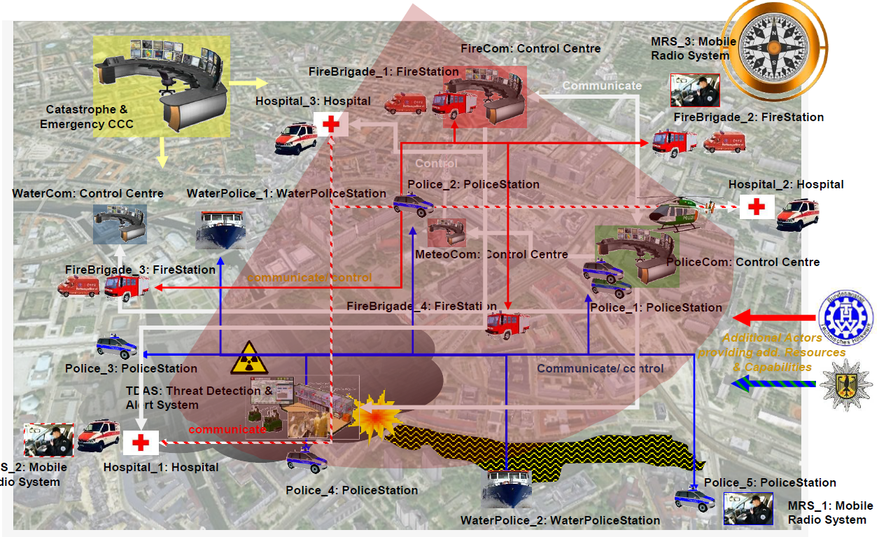
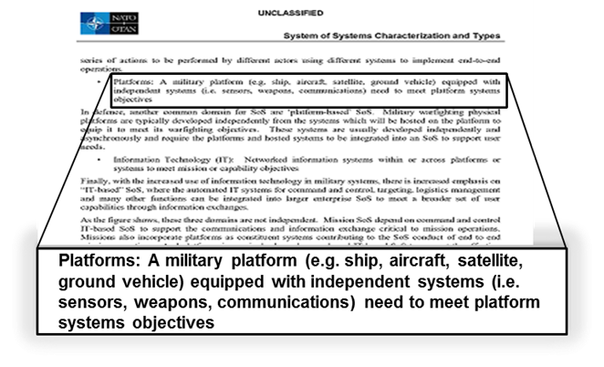
MITRE: Overview of SoS (cont.)
Socio-Technical (Disaster Response)
Scope [7]
Technical
Socio-Technical
Enterprise
Domain [7]
Mission
Platform
Information Technology
[7]NATO STO, "System of Systems Characterization and Types", NATO STO, 2015.

Slide 12
MITRE: Am I dealing with a SoS?
Challenges
SoS Authorities
Leadership
Constituent Systems’ Perspectives
Capabilities and Requirements
Autonomy, Interdependencies, and Emergence
Testing, Validation and Learning
SoS Principles

Slide 13
MITRE: Understanding SOP
Acknowledged SoS in the DoD [8]
Come into existence when something occurs that is important enough to trigger recognition of the SoS and bring into play management and governance processes which cut across established individual systems boundaries.
[8]J. S. Dahmann and K. J. Baldwin, "Understanding the Current State of US Defense Systems of Systems and the Implications for Systems Engineering," 2008 2nd Annual IEEE Systems Conference, Montreal, Que., 2008, pp. 1-7. doi: 10.1109/SYSTEMS.2008.4518994
[9] Office of the Under Secretary of Defense for Acquisition, Technology and Logistics (OUSD AT&L) 2008. Systems of Systems Systems Engineering Guide: Considerations for Systems Engineering in a System of Systems Environment, Washington, DC: Pentagon, (forthcoming).

Slide 14
MITRE: Implementer View SoSE
Wave Model [10]
“A wave model [11] of SoS SE unwinds the trapeze model and then maps the core elements to a more familiar view of SoS SE as a series of six time-sequenced major steps in implementing an SoS SE process.”
“This model has several driving characteristics that reflect the attributes of SoS: Multiple Overlapping Iterations of Evolution, Ongoing Analysis, Continuous Input from External Environment, Architecture Evolution, and Forward Movement with Feedback.”
Note: Flexibility evident by multiple arrows pointing to the same step in the model
[10]Dahmann, J., Rebovich, G., Lane, J. A., Lowry, R., & Baldwin, K. (2011). An Implementers’ View of Systems Engineering for Systems of Systems. Proceedings of IEEE International Systems Conference. Montreal.
[11] The concept of 'Wave Planning' was developed by Dr David Dombkins, see Dombkins, David. Complex Project Management, Booksurge Publishing, South Carolina: 2007.
Notes:
The steps in the wave model are described below: Initiate SoS provides the foundational information to start the SoS SE process, including an understanding of objectives, key users, user roles and expectations, and core systems supporting capabilities. Conduct SoS Analysis provides an analysis of the “as is” SoS and the basis for SoS evolution by establishing an initial SoS baseline and developing initial plans for the SoS engineering efforts. Develop and Evolve SoS Architecture develops and evolves the persistent technical framework for addressing SoS evolution and a migration plan identifying risks and mitigations. Plan SoS Update evaluates the SoS priorities, options and backlogs to define the plan for the next SoS upgrade cycle. Implement SoS Update involves the SoS SE team monitoring implementations at the constituent system level and plans and conducting SoS level testing, resulting in a new SoS product baseline. Continue SoS Analysis involves ongoing analysis that revisits key information (and their containing artifacts) on the state of and plans for the SoS as a basis for future SoS evolution.”
Picture on top

Slide 15
INCOSE: SoS Pain Points Study
Origins of Pain Points [12]
Survey Conducted in 2012
38 Respondents
65 ‘Pain Points’
Major Challenge Areas Identified
[12]Dahmann, J. (2014), 1.4.3 System of Systems Pain Points. INCOSE International Symposium, 24: 108–121. doi:10.1002/j.2334-5837.2014.tb03138.x
Notes:
“The survey was developed during February and March 2012, with several drafts and a pretest before it was released to the community in April with a cutoff of respondents in Mid-May. It was administered over the internet using KWIK Surveys (www.kwiksurverys.com). “
“There were 38 respondents to the survey who reported 65 ‘pain points’. The majority of respondents were from the US (86%). The UK (8%) and Australia (6%) also made significant contributions. Almost all reported extensive (60%) or some (37%) experience working with SoS. Almost all work in the defense sector (94%).”
“The results of the survey were reviewed and sorted into major challenge areas. The key areas and the issues were summarized in a white paper which was presented to the SoSWG in June 2012 for review and comment. Based on the initial feedback, short descriptions of the key pain points were drafted and posted for feedback. Based on this feedback, the pain points were updated and circulated for discussion at the INCOSE International Symposium in June 2013. “
“The survey results identified seven major challenge areas for systems engineering for of SoS.“

Slide 16
Quantitative Analysis Method for System of Systems Architectures

Slide 17
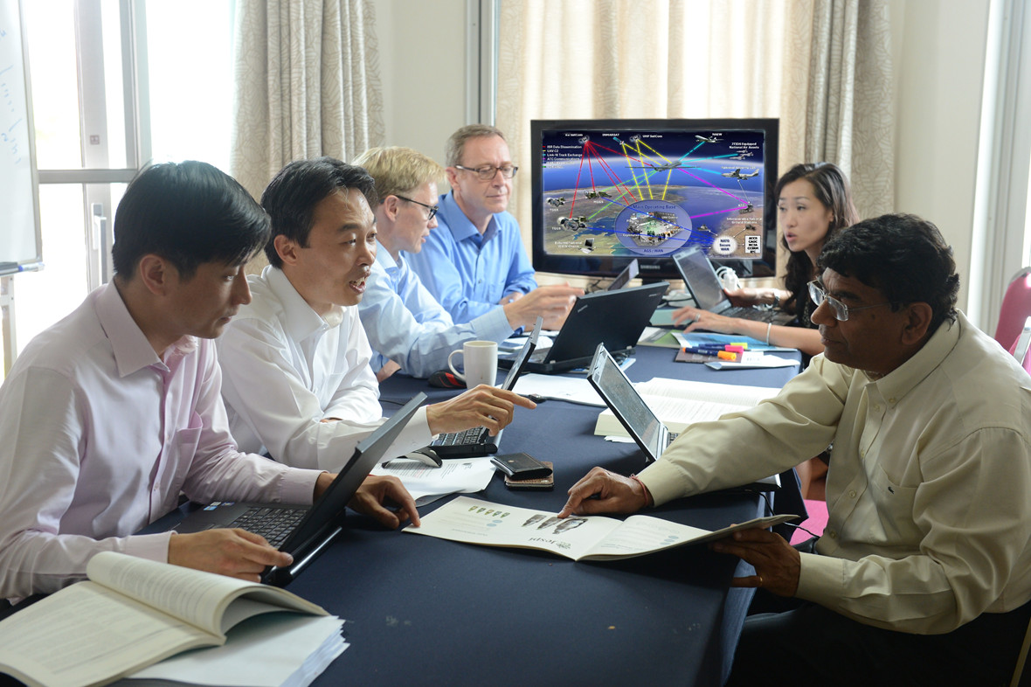
As-is for Evaluating Architectures

Slide 18
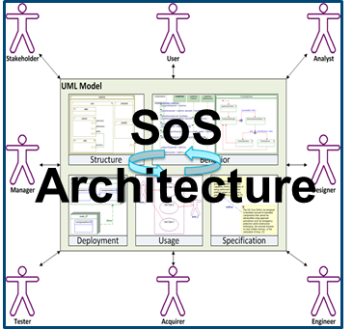
SoS Analysis of Alternatives
Establish baseline SoS architecture
Generate SoS architecture alternatives
SoS graph abstraction and network analysis
MIP contribution: inform prioritization of alternatives using lightweight analytics
Detailed evaluation with M&S environment
Informed architecture selection
Notes:
Slide 2

Slide 19
Robustness Metric (Algebraic Connectivity Value)
Represents average difficulty of isolating a node
Second smallest eigenvalue of a Laplacian Matrix
Inputs:
Degree Matrix
Diagonal matrix that contains the number of nodes adjacent to a given node
Adjacency Matrix
Symmetric matrix that contains a 1 if two given nodes are adjacent and 0 otherwise
Reference: H. Mehrpouyan, B. Haley, A. Dong, I. Y. Tumer, and C. Hoyle, "Resiliency analysis for complex engineered system design," Artificial Intelligence for Engineering Design, Analysis and Manufacturing, vol. 29, no. 01, pp. 93–108, Jan. 2015.
Notes:
How does this value help you make a business decision?
Mathematical calculation makes goodness of architecture determination repeatable and provides objective measure

Slide 20
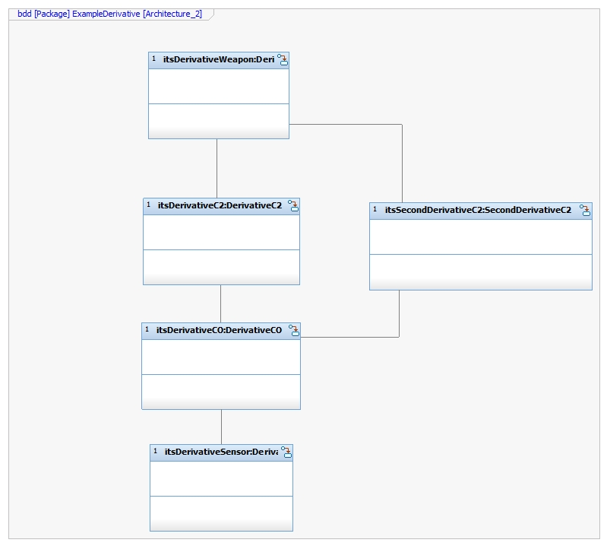
Identifying Resilient SoS Architectures
Architecture 1
Architecture 2
Robustness Metric Value:
0.5858
Robustness Metric Value:
0.8299
Notes:
Add two architectures from demo to show redundancy implying resilience visually which algebraic connectivity value results
Analyzing robustness which is a proxy for resilience based on research

Slide 21
Example Derivation of Algebraic Connectivity Value

Slide 22
Example: Deriving Adjacency Matrix
Sub HDR SATCOM
(1)
Tow Sensor
(2)
Adjacency Matrix Representation
1 | 2 | 3 | 4 | 5 | 6
1
2
3
4
5
6
0 | 0 | 1 | 1 | 0 | 0
0 | 0 | 1 | 0 | 0 | 0
1 | 1 | 0 | 0 | 1 | 1
1 | 0 | 0 | 0 | 0 | 0
0 | 0 | 1 | 0 | 0 | 0
0 | 0 | 1 | 0 | 0 | 0
Integrated Combat System
(3)
External Comms
(4)
Bow Sensor
(5)
Torpedo
(6)

Slide 23
Example: Deriving Degree Matrix
Adjacency Matrix (A)
Degree Matrix (D)
1 | 2 | 3 | 4 | 5 | 6
1 | 2 | 3 | 4 | 5 | 6
1
2
3
4
5
6
0 | 0 | 1 | 1 | 0 | 0
0 | 0 | 1 | 0 | 0 | 0
1 | 1 | 0 | 0 | 1 | 1
1 | 0 | 0 | 0 | 0 | 0
0 | 0 | 1 | 0 | 0 | 0
0 | 0 | 1 | 0 | 0 | 0
1
2
3
4
5
6
2 | 0 | 0 | 0 | 0 | 0
0 | 1 | 0 | 0 | 0 | 0
0 | 0 | 4 | 0 | 0 | 0
0 | 0 | 0 | 1 | 0 | 0
0 | 0 | 0 | 0 | 1 | 0
0 | 0 | 0 | 0 | 0 | 1
Sum row or column
(e.g. Degree of node 3 is 4)

Slide 24
Example: Deriving Laplacian Matrix
Degree Matrix (D)
Adjacency Matrix
Laplacian Matrix
1 | 2 | 3 | 4 | 5 | 6
1 | 2 | 3 | 4 | 5 | 6
1 | 2 | 3 | 4 | 5 | 6
1
2
3
4
5
6
2 | 0 | 0 | 0 | 0 | 0
0 | 1 | 0 | 0 | 0 | 0
0 | 0 | 4 | 0 | 0 | 0
0 | 0 | 0 | 1 | 0 | 0
0 | 0 | 0 | 0 | 1 | 0
0 | 0 | 0 | 0 | 0 | 1
1
2
3
4
5
6
0 | 0 | 1 | 1 | 0 | 0
0 | 0 | 1 | 0 | 0 | 0
1 | 1 | 0 | 0 | 1 | 1
1 | 0 | 0 | 0 | 0 | 0
0 | 0 | 1 | 0 | 0 | 0
0 | 0 | 1 | 0 | 0 | 0
1
2
3
4
5
6
2 | 0 | -1 | -1 | 0 | 0
0 | 1 | -1 | 0 | 0 | 0
-1 | -1 | 4 | 0 | -1 | -1
-1 | 0 | 0 | 1 | 0 | 0
0 | 0 | -1 | 0 | 1 | 0
0 | 0 | -1 | 0 | 0 | 1

Slide 25
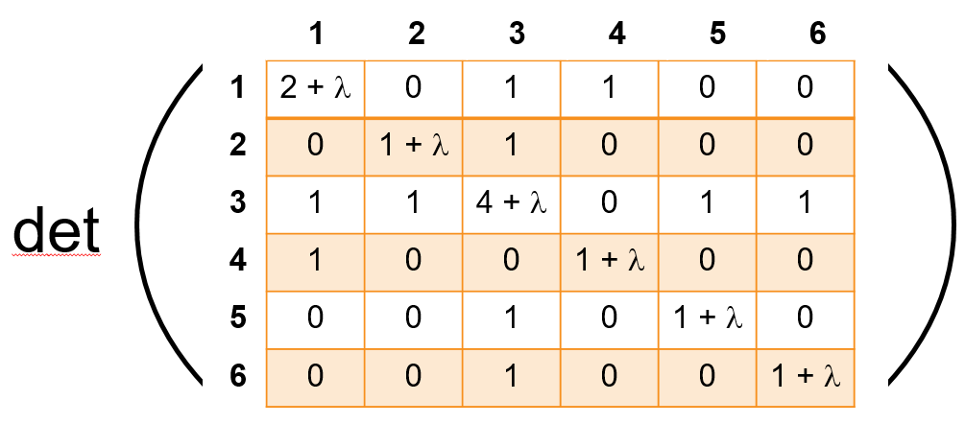
Example: Calculating Eigenvalues
0
When λ = 0, 0.486, 1, 2.428, or 5.086
Therefore, 0.486 is the algebraic connectivity value

Slide 26
Summary
Systems of Systems Engineering is a growing area of practice
Mathematics provides a core foundation for SoS analysis and engineering

